Slide 1
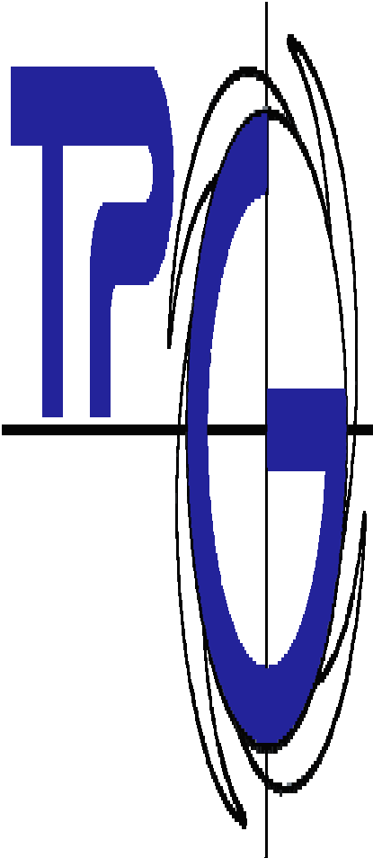

Advanced Methods of Monitoring and Design of Systems
University of Genoa
Regression
Prof. Alessandro Sorce
Yaghoub Silavi (5672053)

Slide 2

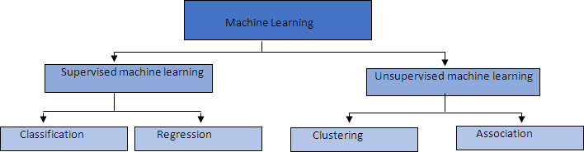
Machine Learning
University of Genoa
Develop Predictive Model based on both input and output data
Group and interpret data based only on input data
The output is categorical (or discrete)
The output is numerical (or continuous) => model
partitioning the unlabeled dataset into groups
rule‐based method interesting
machine learning
for discovering relations between
variables in large databases
AMMDS 2019
2

Slide 3
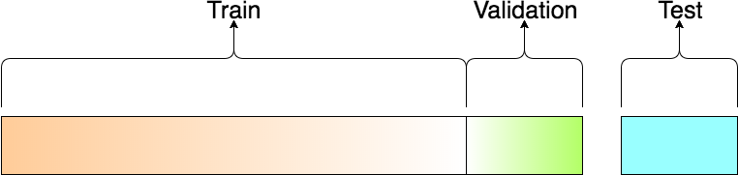
Data‐Driven Technique for regression
University of Genoa
Training Dataset: The sample of data used to fit the model.
The actual dataset that we use to train the model (weights and biases in the case of Neural Network). The model sees and
learns from this data
Validation Dataset: The sample of data used to provide an unbiased evaluation of a model fit on the training dataset while tuning model hyperparameters.
Test Dataset: The sample of data used to provide an unbiased evaluation of a final model fit on the training dataset. The Test dataset provides the gold standard used to evaluate the model. It is only used once a model is completely trained(using the train and validation sets). The test set is generally what is used to evaluate competing models
Dependent on the data
Refine the model
Test the results
Build the model
AMMDS 2019
3

Slide 4
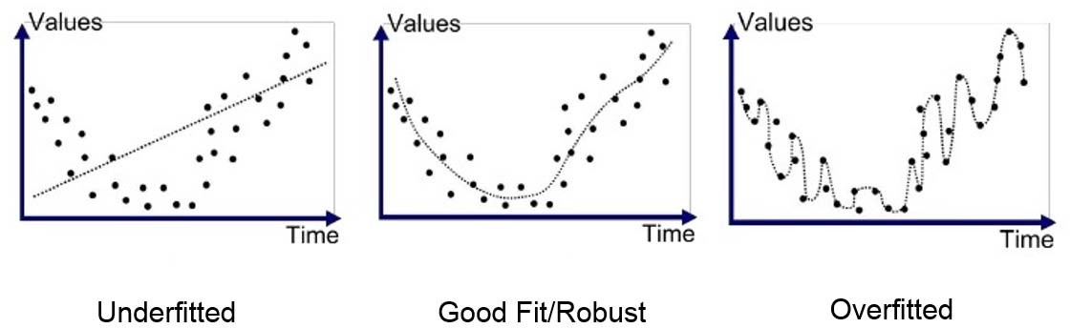
Under Fitting and Overfitting
University of Genoa
Underfitting happens when your model is too simple to reproduce the underlying data structure. A model is said to have high bias
Over Fitting "the production of an analysis that corresponds too closely or exactly to a particular set of data, and may therefore fail to fit additional data or predict future observations reliably“
Overfitting is particularly likely to occur when the size of the training data set is small, or when the number of parameters in the model is large.
Fitting the current data too well results in a model that does not generalize well to other data, and gives an overly‐ optimistic estimate of the expected error
Overfitting occurs when the model begins to memorize training data rather than learning from them in order to
generalize
Data is key because it can help you both: ‐ Reduce variance (overfitting) with more training examples ‐ Reduce bias (underfitting) with more feature

Slide 5
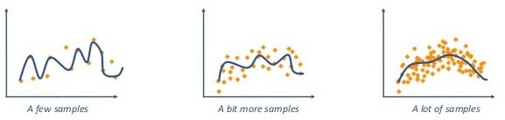
Avoiding Overfitting
University of Genoa
1 Increase the Training Data size
More training examples there are, the more complex for an algorithm to fit the noise in the data therefore the fitted model will be less sensitive to noise and will better generalize
2 Less Features – Variables Selection
Some features might contain more noise than informative data for your model. This is especially the case when the features are non‐informative or correlated with other features. Remove them and your model will not take this noise into account anymore
3 Decrease Complexity – Model Selection
Increase the number of parameter of your model

Slide 6
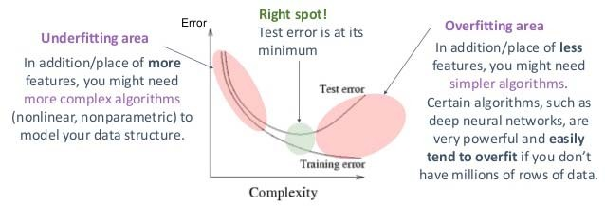
Avoiding Underfitting
University of Genoa
More Features – Variables Selection
If your model is underfitting, it might be because you did not give it enough informative features
Increase Complexity – Model Selection
If your model is underfitting, it might be because you did not give it enough parameter to train (e.g. a linear model for a NL problem)

Slide 7




Evaluating the goodness of fit
University of Genoa
The sum of squares due to error (SSE)
This statistic measures the total deviation of the response values from the fit to the response values. It is also called the summed square of residuals and is usually labeled as SSE.
A value closer to 0 indicates that the model has a smaller random error component, and that the fit will be more useful for prediction.
Usually w_{i}, the weight vector, is equal to one
Regression results
R‐square
This statistic measures how successful the fit is in explaining the variation of the data. Put another way, R‐square is the square of the correlation between the response values and the predicted response values. It is also called the square of the multiple correlation coefficient and the coefficient of multiple determination.
Input Average

Slide 8

Evaluating the goodness of fit
University of Genoa
Root mean squared error (RMSE)
This statistic is also known as the fit standard error and the standard error of the regression. It is an estimate of the standard deviation of the random component in the data, and is defined as
where MSE is the mean square error or the residual mean square
Just as with SSE, an MSE value closer to 0 indicates a fit that is more useful for prediction.
The advantage of RMSE over the MSE is that has the same unit of measurement of the fitted/regressed variables

Slide 9
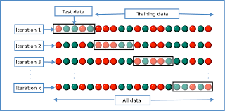
Cross Validation
University of Genoa
Cross‐validation is a model assessment technique used to evaluate a machine learning algorithm’s performance in making predictions on new datasets that it has not been trained on. This is done by partitioning a dataset and using a subset to train the algorithm and the remaining data for testing. Because cross‐validation does not use all of the data to build a model, it is a commonly used method to prevent overfitting during training.
Each round of cross‐validation involves randomly partitioning the original dataset into a training set and a testing set. The training set is then used to train a supervised learning algorithm and the testing set is used to evaluate its performance. This process is repeated several times and the average cross‐validation error is used as a performance indicator.

